Slide 1

March 2015 GP Survey: Are you getting paid fairly?

Slide 2
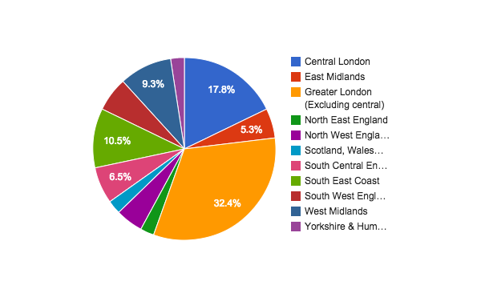
Where do you work?
Are you being paid fairly?

Slide 3
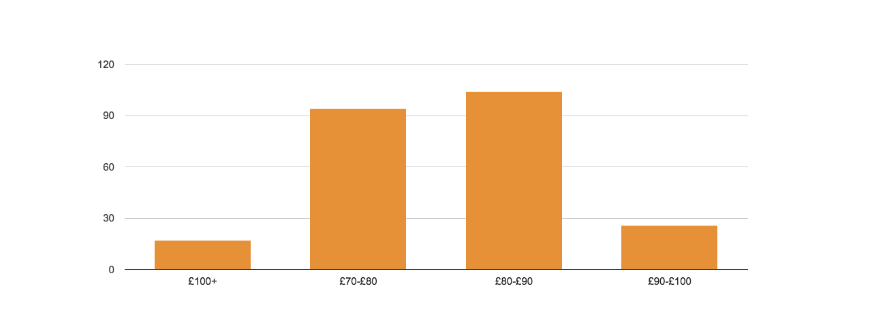
In the last 12 months what is the highest hourly rate for regular (>2 days notice) locum work that you received?
Are you being paid fairly?

Slide 4
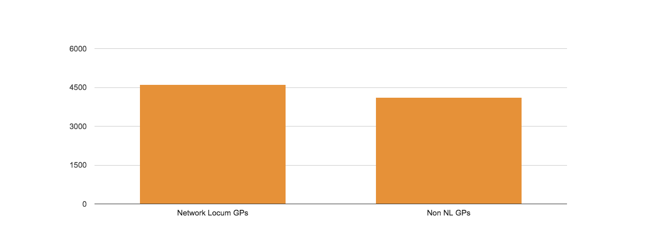
Average monthly wage for locum work
Are you being paid fairly?

Slide 5
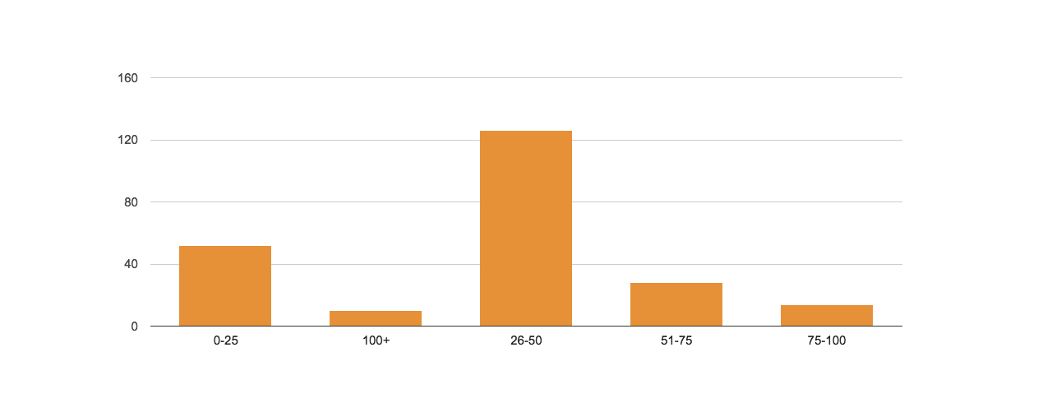
Days off
Are you being paid fairly?

Slide 6
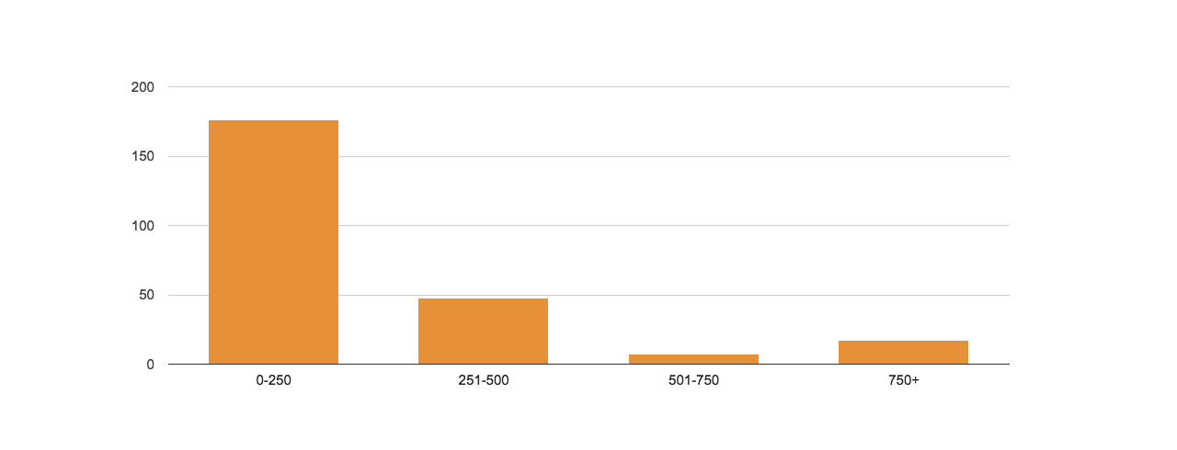
CPD cost per month
Are you being paid fairly?

Slide 7
Average home visits
22
Are you being paid fairly?

Slide 8
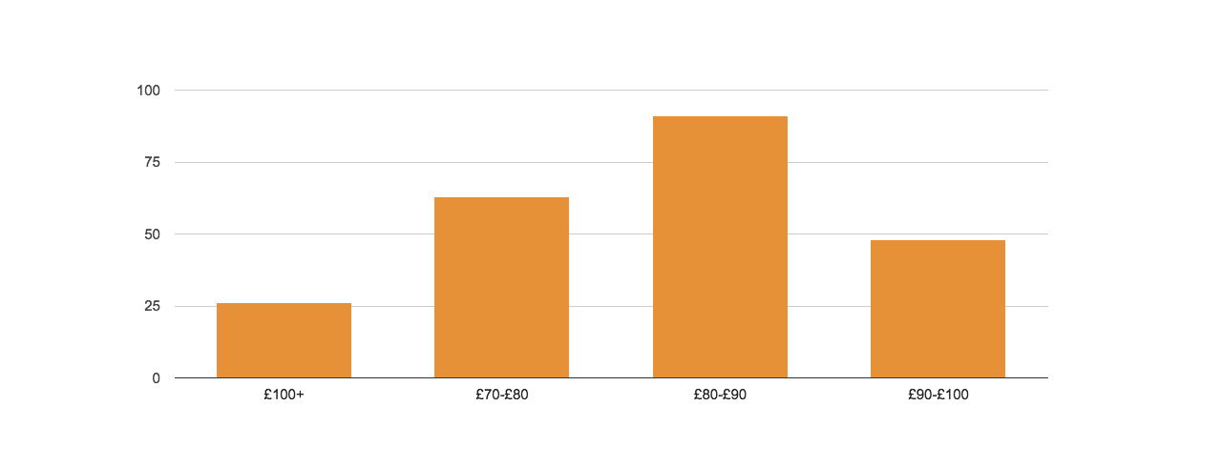
In the last 12 months what is the highest hourly rate for emergency (< 2 days notice) locum work you’ve received?
Are you being paid fairly?

Slide 9

Do you claim pension?
Are you being paid fairly?

